Slide 1
Adventure Works House Stark
Hemanth Potti
Animesh Agrawal
Vivek Nakka
Vishrutha Gopal

Slide 2
Dataset
Customers
Internet Sales
Product
Sales Territory
Geography
Date

Slide 3
Project Objectives
Task 1:
Clean up data
Analyze data and get insights in the given context
Use visualization
Task 2:
Build a relational schema for the tables, include normalization if needed
Load the data into the database
Task 3:
Build a flask application with following objectives
Search for customers using name, id or phone number
Display their details
Task 4:
Create a Power BI dashboard and tell a story
Suggest business improvements
Task 5:
Migrate the project to AWS, choosing appropriate services

Slide 4
Task -1 : Data Analysis
The given dataset has been analysed through various analysis tools such as Python, Pandas, Matplotlib, Seaborn.
The Jupyter notebook provides us with different analysis performed on the dataset to understand what the data is about.

Slide 5
Data Cleaning
Data cleaning is the process of detecting and correcting (or removing) inaccurate, incomplete, or irrelevant data from a dataset.
Data cleaning involves various steps such as handling missing values, removing duplicates, correcting errors, and standardizing data formats.

Slide 6


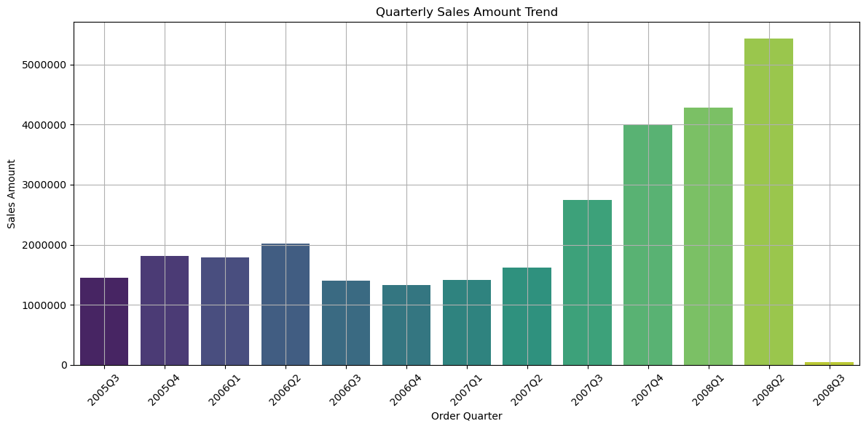


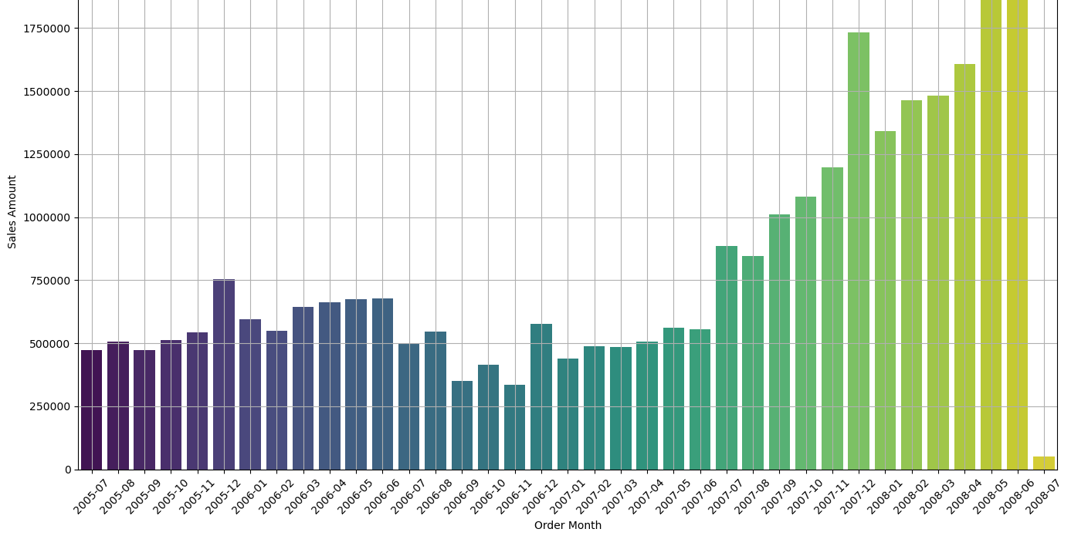

Visualization

Slide 7
Task – 2 : Database
Upon analysis, the next step is to push the data into a database for querying and further analysis.
The data has been pushed into the oracle database.
Querying has been achieved through the SQL Developer tool.

Slide 8
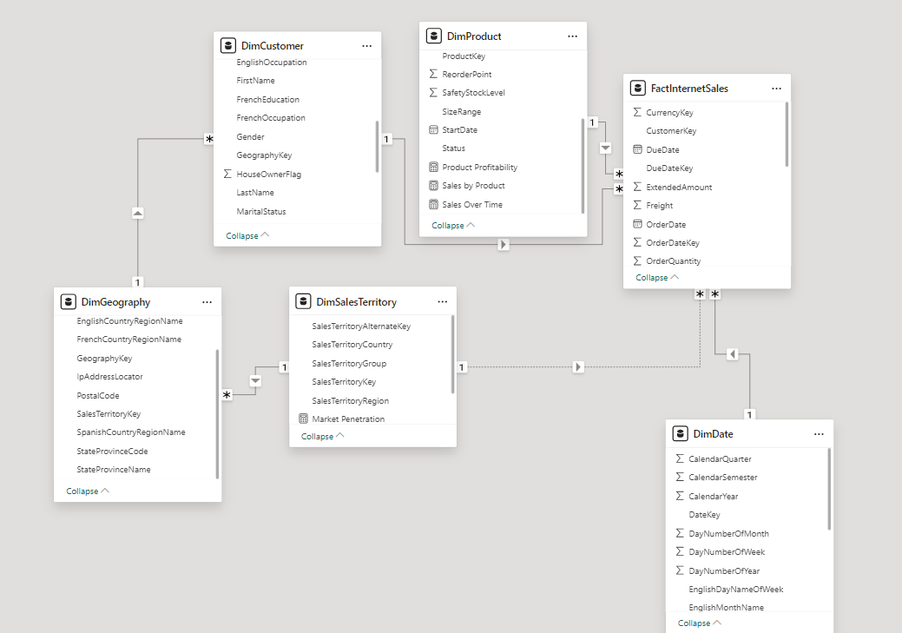

Slide 9
Let’s query the data!
Top 5 customers details who made the highest purchases.
The one product which made the highest profit.
Year wise sales numbers
Region wise sales numbers
List the products that have a Spanish name and how much profits did they make overall

Slide 10
Task – 3 : Python and Flask
The data needs to be displayed to the end user.
Flask has been used to extract the data from the oracle database and is displayed on the webpage.
The end user can search through the records with a unique customer key or email.

Slide 11
Task – 4 : Power BI
Business Analysis is an important step for any data.
Power BI has been used for this data to visualise each and every detail.
Multiple plots and measures have been calculated which tells us the overall story of the data.

Slide 12
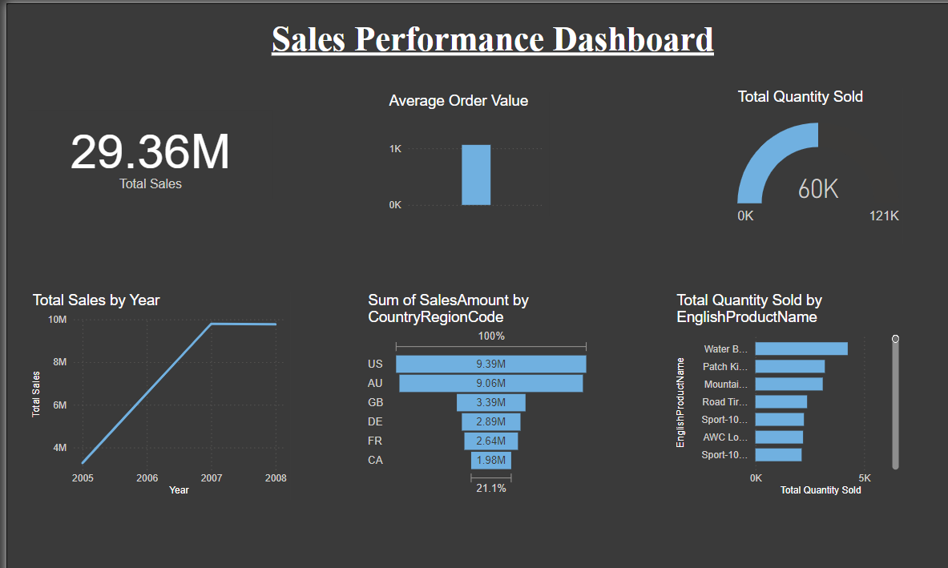

Slide 13
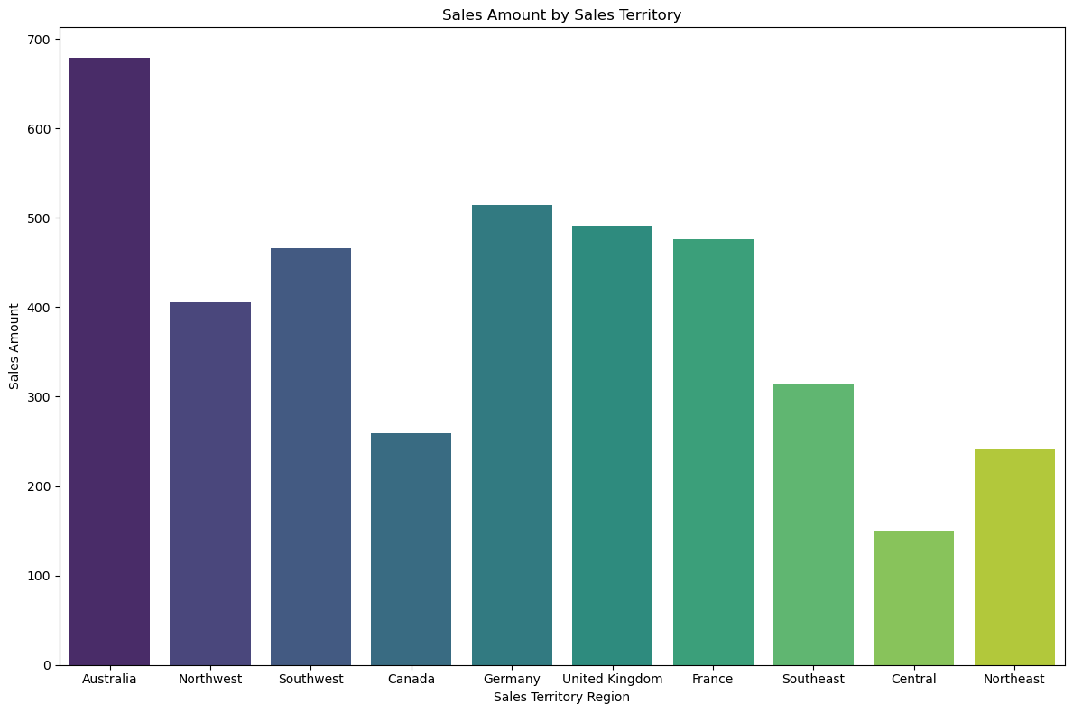
Business Improvements
Sales Territory Management
Target the under-performing territories and allocate resources effectively.
Conduct surveys and marketing campaigns in the under-performing areas.

Slide 14
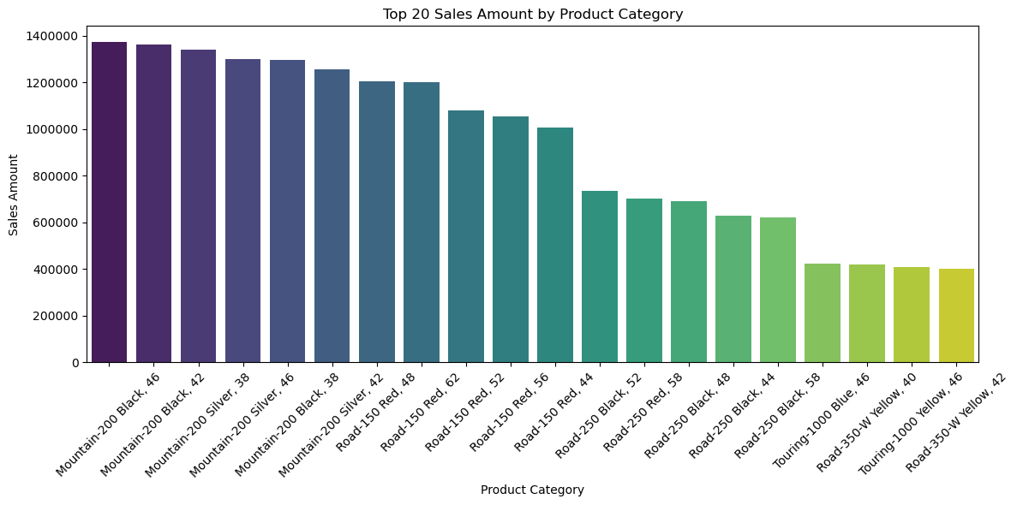
Business Improvements
Product Performance Optimization
Identifying top selling products.
Promoting the best-selling products to boost overall sales.
Optimize inventory management.

Slide 15
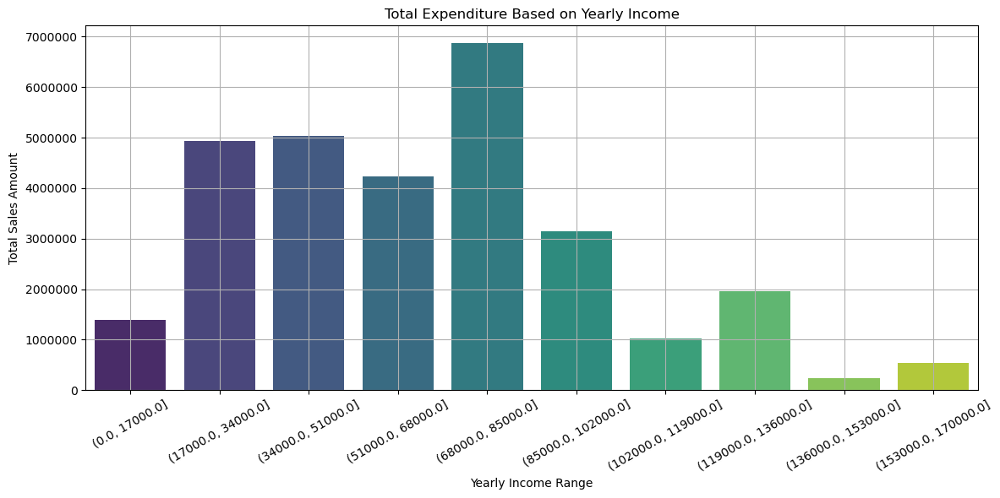
Business Improvements
Customer Segmentation
Target the high-earning customers and launch a new range of premium products.

Slide 16
Task – 5 : AWS Cloud Migration
The datasets have been migrated into an S3 Bucket.
Amazon sagemaker has been used to analyse and query on the data.

Slide 17
Conclusion
The given data has been, analysed, queried, implemented, visualised and (has been migrated to AWS).
Various tools and softwares have been used in performing the tasks such as, SQL Developer, Power BI, Flask, Pandas.

Slide 18
Thank You!

